Slide 1
Philosophy of our Government
August 17, 2015

Slide 2
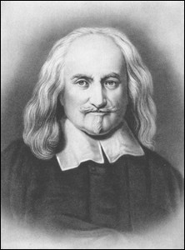
Thomas Hobbes
Thomas Hobbes wrote Leviathan. (after he fled to France during the English Civil War)
Humans without government “live in a state of nature” which he said was a “state of war against all”
To avoid this life, people should agree to set up a government to protect people.
This is a “Social Contract”
People can not break this contract.

Slide 3
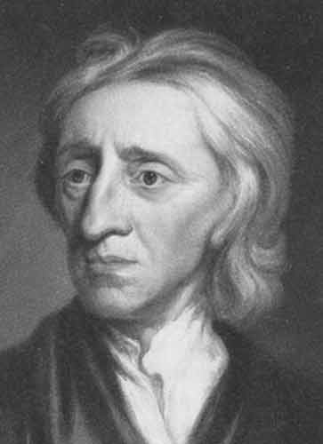
John Locke
Physcian/philosopher/scientist
He said the social contract should lead to a LIMITED GOVERNMENT.
Limited government: The government serves the people/individual. It is there to protect our rights!
“life, liberty, and property”
He wrote The 2nd Treatise of Government
FORBIDDEN! Because of its liberal views.

Slide 4
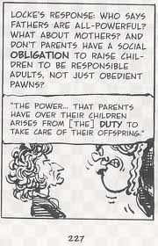

Slide 5
Montesquieu
French noblemen and lawyer
The Spirit of the Laws 1748
In this book he wrote about the importance of Separation of Powers within a government
FORBIDDEN! Because of its liberal views.
Constitutional Government: limited government. A constitution is the form of law that everyone abides by.

